Slide 1


Welcome to Our presentation
Group members:
Safal Acharya
Sajag Shrestha
Riden Poudel
Rangin Basnet

Slide 2
INTRODUCTION
The project aims to build a complete library management database system for UPA university as per their request. The project is named "Cosmic library".
Before the project begins all the business rules of the university library are determined.
Once the business rules are finalized, the entities, attributes and relationship between the entities are also finalized. Then ERD is formed accordingly.
After that database schema is generated with the help of which normalization is carried out.

Slide 3
Disadvantages of using file based system
Data Redundancy
Data Inconsistency
Accessing Anomalies
Poor Data Integrity

Slide 4
Advantages of database and DBMS
Easier Data Access
Improved Data Security
Limited Data Redundancy
Minimized Data Inconsistency

Slide 5
Business Rules
The library won't lend some books, such as reference books, journals, etc. So, the students should be able to differentiate between the books which can be lent and which can’t.
The books are tagged with assorted colors and for Lecturers, they are permitted to borrow green tagged books. They can return the book after an interval of one month.
Students are permitted to lend a maximum of five books at a time.
Students are reminded of their return date through an e-mail a day before the due date.

Slide 6
Normalization Un Normal Form (UNF)
The data model where the relational model does not meet any of the conditions of normalization is UNF.
Based on the case study let us take an example of Un Normal Form (UNF):

Slide 7
Un Normal Form (UNF)
Student-ID | Name | Status | Address | Book | Publisher | Phone no:
SushiUPA220085 | Sushi | BE | Kathmandu | Quantum+ | ABC | 9856008722
BikashUPA220016 | Bikash | MD | Paris | Nuclear | JPT | 9865523471
IsaiahUPA220025 | Isaiah | BE | Beijing | Business+ | BMW | 9875268210
SacarUPA220025 | Sacar | PHO | Delhi | All inc | JMC | 9988712956, 9866502144
Un Normal Form is illustrated in the above table having values in same row consisting of varying attributes. It can be further normalized as it results in issues like repetition of data.

Slide 8
First Normal Form (1NF)
Certain settings should be followed to perform the first normal form that are enlisted below:
Each cell should be single valued i.e. atomic.
Duplicate rows are avoided in the table.
Arrays are not repeated.
Therefore, the 1NF table is created on the basis of above settings:

Slide 9
First Normal Form (1NF)
Student-ID | Name | Status | Address | Book | Publisher | Phone no:
SushiUPA220085 | Sushi | BE | Kathmandu | Quantum+ | ABC | 9856008722
BikashUPA220016 | Bikash | MD | Paris | Nuclear | JPT | 9865523471
IsaiahUPA220025 | Isaiah | BE | Beijing | Business+ | BMW | 9875268210
SacarUPA220025 | Sacar | PHO | Delhi | All inc | JMC | 9988712956
SacarUPA220025 | Sacar | PHO | Delhi | All inc | JMC | 9866502144
The table is normalized into first form according to the requirement and each row has diverse values. There are 2/2 rows in above table with same student_id so the row was diversely identified.

Slide 10
Second Normal Form (2NF)
After the normalization of first form, it should be normalized to second form. Certain settings should be followed to perform the second normal form that are enlisted below:
It should be in first normal form
Partial dependencies should not exist between non-key attributes and key attributes.
Therefore, the 2NF table is created on the basis of above settings:

Slide 11
Second Normal Form (2NF)
Conversion of 1NF to 2NF:
Student-ID | Name | Status | Address
SushiUPA220085 | Sushi | BE | Kathmandu
BikashUPA220016 | Bikash | MD | Paris
IsaiahUPA220025 | Isaiah | BE | Beijing
SacarUPA220025 | Sacar | PHO | Delhi
i) Student Details (2NF)

Slide 12
Second Normal Form (2NF)
Conversion of 1NF to 2NF:
Book | Publisher | Phone no:
Quantum+ | ABC | 9856008722
Nuclear | JPT | 9865523471
Business+ | BMW | 9875268210
All inc | JMC | 9988712956
ii) Contact Details (2NF)

Slide 13
Second Normal Form (2NF)
Conversion of 1NF to 2NF:
Publisher | Phone no:
JMC | 9988712956
JMC | 9866502144
iii) Contact Details (2NF)

Slide 14
third Normal Form (3NF)
After the normalization of second form, it should be normalized to third form. Certain settings should be followed to perform the third normal form that are enlisted below:
It must be in 2NF.
There must not exist any transitive dependencies between the non-key attributes and key attributes.
Therefore, the 3NF table is created on the basis of above settings:

Slide 15
Third Normal Form (3NF)
Conversion of 2NF to 3NF:
Student-ID | Name | Status | Address
SushiUPA220085 | Sushi | BE | Kathmandu
BikashUPA220016 | Bikash | MD | Paris
IsaiahUPA220025 | Isaiah | BE | Beijing
SacarUPA220025 | Sacar | PHO | Delhi
i) Student Details (3NF)
The above table i) already reduced to 3NF so it doesn't need to be further normalized.

Slide 16
Third Normal Form (3NF)
Conversion of 2NF to 3NF:
Book | Publisher
Quantum+ | ABC
Nuclear | JPT
Business+ | BMW
All inc | JMC
Publisher | Phone no:
ABC | 9856008722
JPT | 9865523471
BMW | 9875268210
JMC | 9988712956
ii) (3NF)
ii) (3NF)

Slide 17
Simple ERD

Slide 18
Database Schema

Slide 19
Finalized ERD

Slide 20
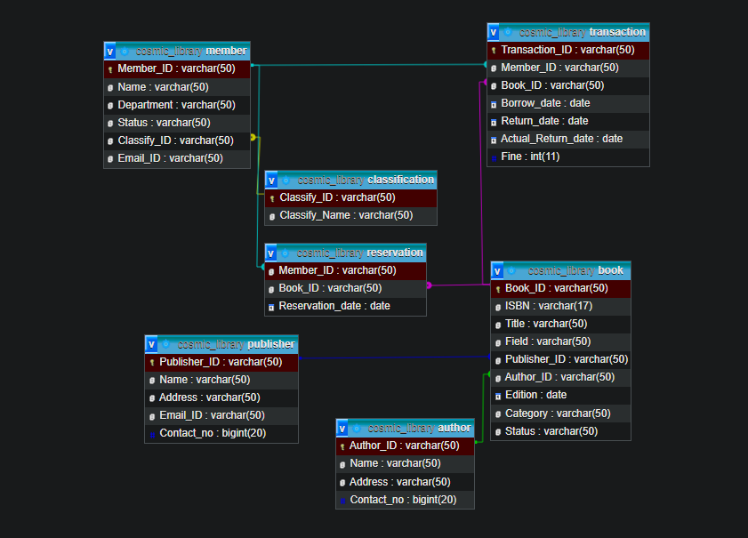
Database diagram

Slide 21
Data Definition Language (DDl)

Slide 22

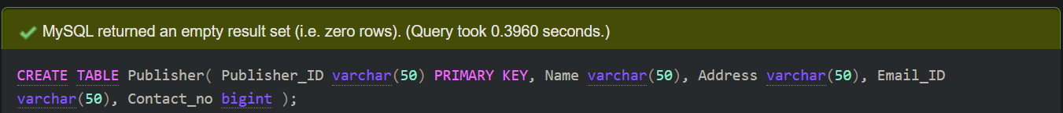
Create database
Create Table
Publisher Table:

Slide 23
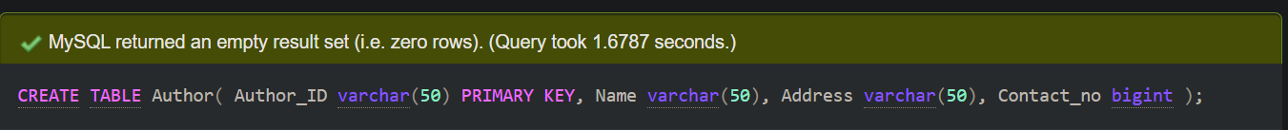
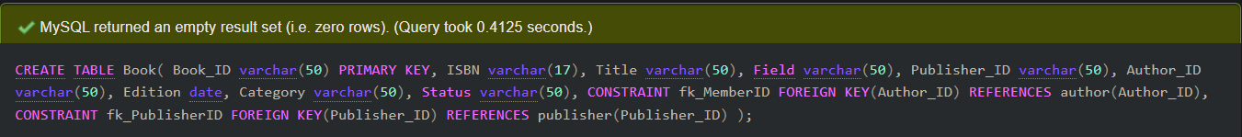

Author Table:
Book Table:
Classification Table:

Slide 24
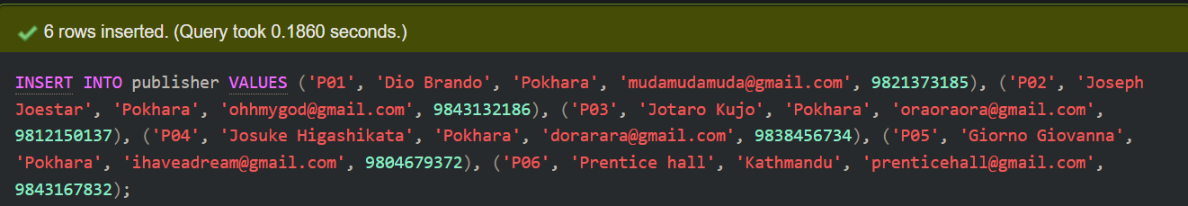
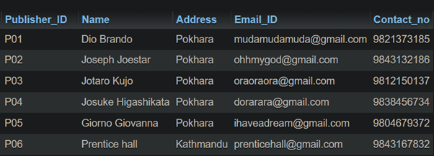
Insert int0 Table
Publisher Value:

Slide 25
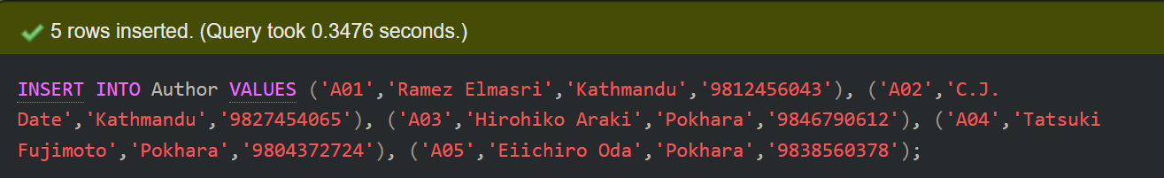
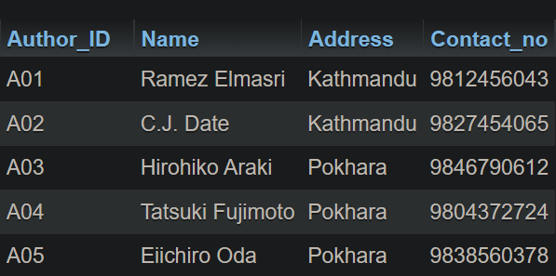
Insert int0 Table
Author Value:

Slide 26
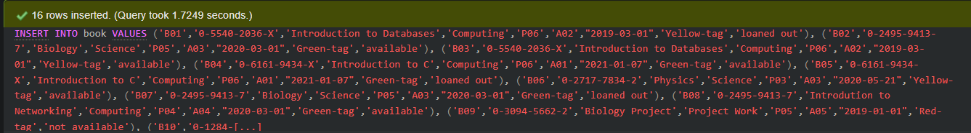
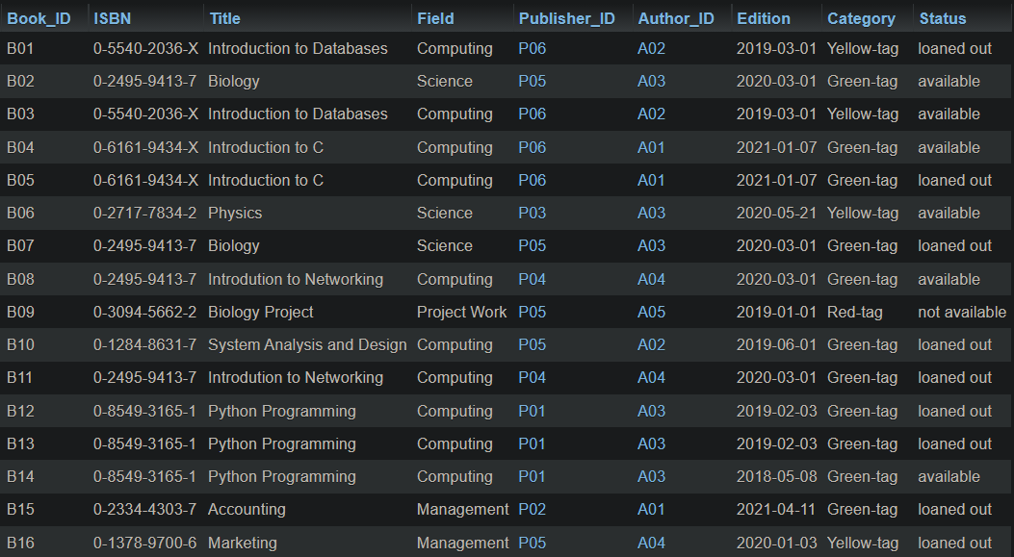
Insert int0 Table
Book Value:

Slide 27
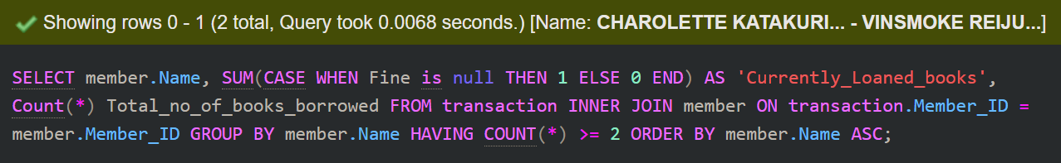
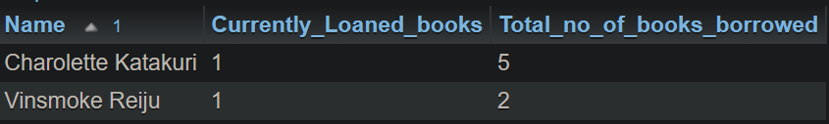
DML 1st Query

Slide 28
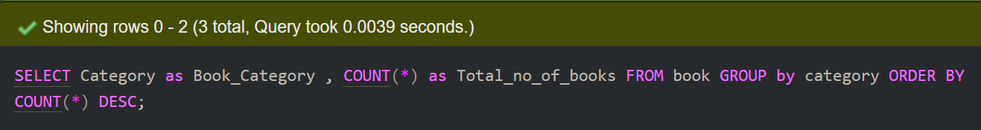
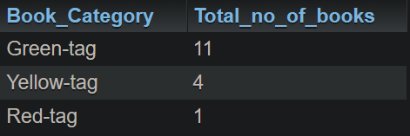
2nd Query

Slide 29
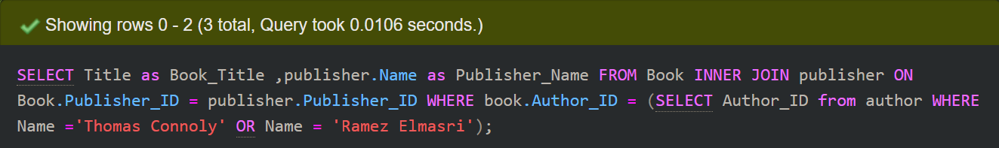

3rd Query

Slide 30
Workload matrix
 | Rangin Basnet | Safal Acharya | Sajag Shrestha | Riden Paudel
Pros and cons | 40% | 10% | 40% | 10%
Business Rules | 10% | 40% | 10% | 40%
Normalization | 15% | 55% | 15% | 15%
ERD | 40% | 10% | 40% | 10%

Slide 31
Conclusion
We had a great experience as a group doing the project. It was a great learning experience.
We learnt working in group and coping with problems in group.
We would like to thank our module teacher Er. Isha Baral for her kind cooperation through the process.

Slide 32
References
Hector Garcia-Molina, Jeffrey D. Ullman, Jennifer Widom: 2009,
Pearson Prentice Hall Database System the Complete Book. Pearson Prentice Hall: Available at: https://people.inf.elte.hu/miiqaai/elektroModulatorDva.pdf
Ben Brumm, Jun 23, 202I, Database Design for a Library Management System [Video] https://youtu.be/yldrIdoXiYk
Paul Beynon-Davies, Third Edition, Database Systems.
Raghu Ramakrislhanan & Johannes Gehrke. Database Management System, Second Edition.

Slide 33

Thank you for your attention

